Slide 1
Photo: krass99 - Fotolia
Agile application development
How APEX is used at Deutsche Bahn AG
DB Systel GmbH | Matthias Nöll, Richard Rieb | Stockholm | 2017-08-30

Slide 2
Outline
1.
Small Solutions at Deutsche Bahn AG
2.
Our Focus
3.
The Small Solutions Way
4.
Bonus: Database Architecture

Slide 3
What is Deutsche Bahn AG?
Photo: DB AG

Slide 4
Small Solutions at Deutsche Bahn AG
Who we are:
20 employees in Berlin and Frankfurt/Main
several external experts
What we maintain:
More than 300 applications
Over 120 customers from 35 subsidiaries
Berlin
What we offer:
Frankfurt/Main
application development
brainstorming with our “Impulswand”
efficient polling with our “Survey”
arrange events with our “Eventmanger”

Slide 5
Typical Problems in Large Corporations
1. Structure & Compliance
historically grown structures
6
6. Complex System standard software not useful; many adjustments necessary
1
5
2. Lengthy Processes coordination between the involved parties
5. One's Own Initiative of Business Areas many solutions for similar problems
2
3. Changing Business Models liberalization of the railway sector
4. No Focus on Small Projects long-standing know how in middle and big projects
4
3

Slide 6
Focus of Small Solutions Projects
Non-Critical Topics
Simple Processes
Inexpensive Solutions

Slide 7
Our Foundation
01
02
03
04
STANDARDIZATION
REUSABILITY
MAINTAINABILITY
QUALITY BY TRANSPARENCY
95:5 rule, lean documentation, protocol of the initial interview, cost estimate, CD,
db platform
Use of corporate know how,
product development
(Survey, Meet, Impulswand)
Declarative Development with APEX → easy access
for new developers
Early integration of customers, strong collaboration, multiple iterations

Slide 8
The Small Solutions Standard
Application Template
Default application with corporate styles and basic features
Single-Sign-On (SSO)
Simple Integration by an own authentication scheme
Page Authorizations
Declarative authorizations for navigation and pages
Jasper
Pre-configured link to Jasper-Servers
LotusNotes-Mail
LotusNotes webservice integration (corporate default)
Import-Tool
Declarative configuration for importing structured text files (.txt, .csv, …)

Slide 9
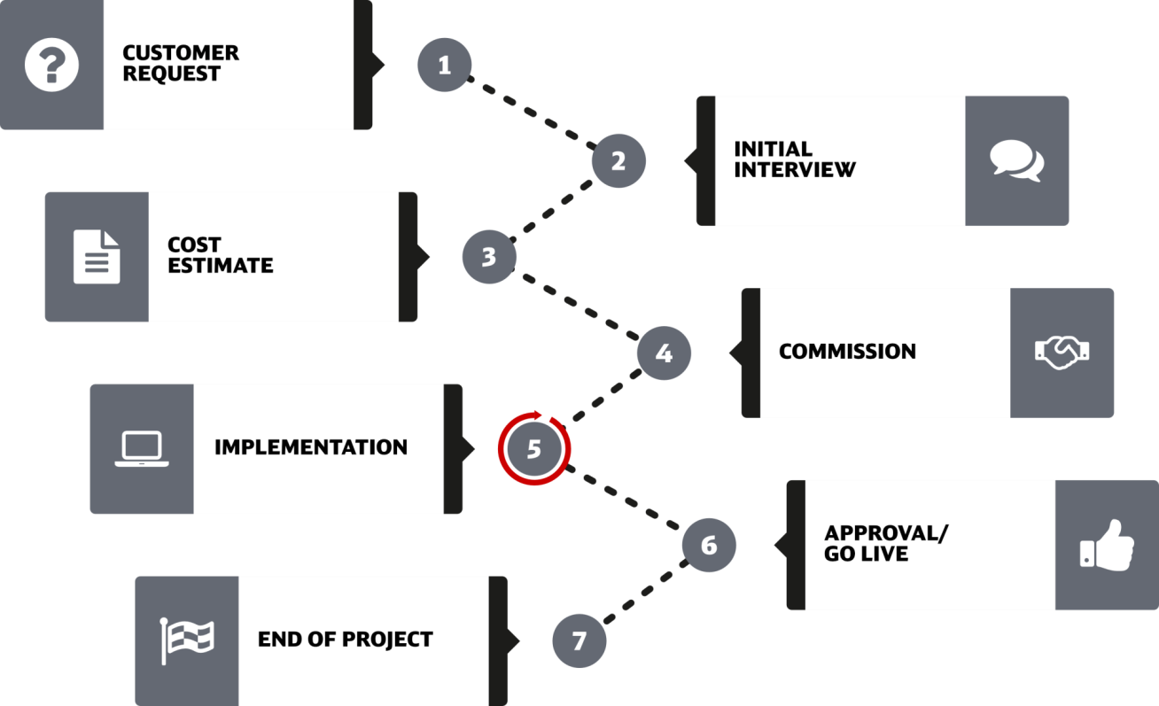
The Small Solutions Way

Slide 10
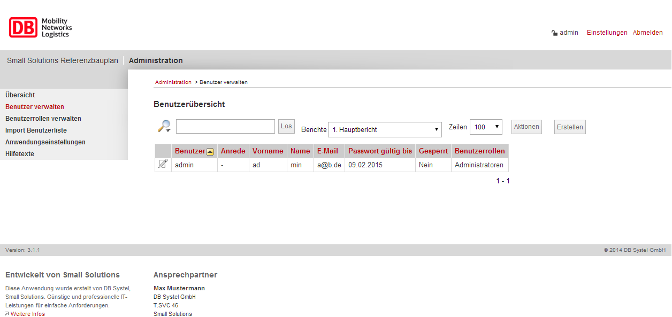
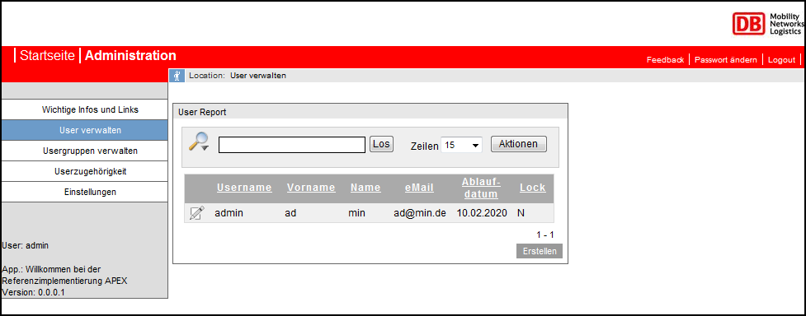
The Evolution of Small Solutions
2011
Initial Version of the Template
Second Version of the Template

Slide 11
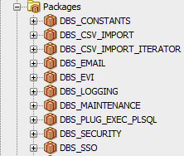
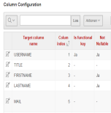
Single-Sign-On (SSO)
LotusNotes-Mail
JasperReports
Import-Tool
Product Development
Current Version of the Template based on the UT
Demo
Today

Slide 12
Live-Demo of the Template

Slide 13
Summary of our Standard
Opportunities with APEX (SQL, PL/SQL, JS, jQuery, …)
Small Solutions Standard
APEX Standard

Slide 14
Bonus: Database Architecture
Client
APACHE
Linux Server
TOMCAT
ORDS
ORACLE
DB

Slide 15
Bonus: Database Architecture
CDB
APEX Engine-/Metadata
APEX Engine-/Metadata
Data
Data
Schema
Schema
Schema
Schema
Schema
Schema
Schema
Schema
PDB
PDB

Slide 16
Thank you for your attention!
Any questions?
Matthias Nöll
Richard Rieb
tel.: +49 30 297 58786
mobile: +49 151 27404633
matthias.noell@deutschebahn.com
DB Systel GmbH
Caroline-Michaelis-Str. 5 - 11
10115 Berlin
www.dbsystel.de
tel.: +49 69 265 15099
mobile: +49 160 97401320
richard.rieb@deutschebahn.com
DB Systel GmbH
Jürgen-Ponto-Platz 1
60329 Frankfurt am Main
www.dbsystel.de
Business Solution Development Solutions 4 Smart Business Small Solutions (D.IPB 25)
Business Solution Development Solutions 4 Smart Business Small Solutions (D.IPB 25)

